Slide 1

Tree Building and Phylogenetic Analysis
Kathryn Campbell

Slide 2
Schedule
Alignments & Understanding Trees 12:00-13:00
Alignments
Practical: Viewing and aligning sequences
Terminology
Tree building methods
Practical: Interpreting phylogenetic trees
Tree Building 14:00-15:00
Substitution models
Statistical support (bootstrapping, posterior probabilities)
Practical: Using modeltest and IQTREE2 to find the best substitution model and generate a maximum likelihood tree
Visualisation using FigTree
Annotating using metadata
Practical: Preparation of publication ready trees with appropriate annotation and bootstrapping in FigTree
Further Phylodynamics and Phylogeography 15:00-15:30
Introduction to BEAST
Trees with temporal and spatial information
Recreation of transmission routes using SPREAD
Practical: Viewing of premade BEAST trees in FigTree, viewing premade SPREAD kml files in Google Earth

Slide 3
Alignment
An alignment tries to guess how sequences are related to eachother
This way we can determine homology between sequences, i.e. the similarities between the sequences
Sequence alignments can be pairwise:
only between two sequences
BLAST, DIAMOND
Or multiple sequence alignments:
between more than one homologous sequences
MAFFT, Clustal, MUSCLE, T-Coffee, Kalign
(this is what we're going to focus on here)

Slide 4
Alignment
We can try to see how sequences compare to eachother:
A | T | C | G | A | T | C | G
A | T | C | G | A | T | G | G
A | T | C | G | A | T | C | C | G
A | T | C | G | A | T | C | - | G
A | T | C | G | A | T | G | - | G
A | T | C | G | A | T | C | C | G
It can be more accurate to do this by eye, as algorithms can make mistakes!
BUT this quickly becomes very difficult with lots of long sequences
Instead, we use algorithms and then check by eye to make sure it looks sensible!

Slide 5
Alignment
Building a tree first requires an alignment
Need to be able to see the unbroken history of each nucleotide to determine changes over time and relatedness of sequences
This can be an issue when indels have occurred
Need an algorithm to determine the least costly alignment
SpA ATGCAGGTA
SPB ATGCTGCTA
SpC ATGCAGCTC
SpD TAGCAGGAC

Slide 6
Phylogenetic Analysis Steps
Collect homologous sequences
Conduct multiple alignment
Fit an appropriate substitution model
Estimate tree(s) under that model
Test the reliability of the estimated tree(s)
Interpret and apply the phylogenetic tree
Potentially repeat steps 4-6 using different tree building methods and/or additional data

Slide 7
Phylogenetic Analysis Steps
Collect homologous sequences
Conduct multiple alignment
Fit an appropriate substitution model
Estimate tree(s) under that model
Test the reliability of the estimated tree(s)
Interpret and apply the phylogenetic tree
Potentially repeat steps 4-6 using different tree building methods and/or additional data
Follow the instructions in day4_alignment.md

Slide 8
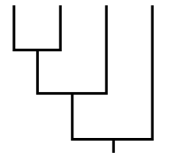
Why use phylogenies?
Molecular clocks e.g. “How long ago since two groups split?”
Ancestral state change e.g. “Movement rate between population A and B?”
Selection e.g. “Which genes or sites have undergone adaptive change?”
Demographic reconstruction e.g. “How has population size changed through time?

Slide 9
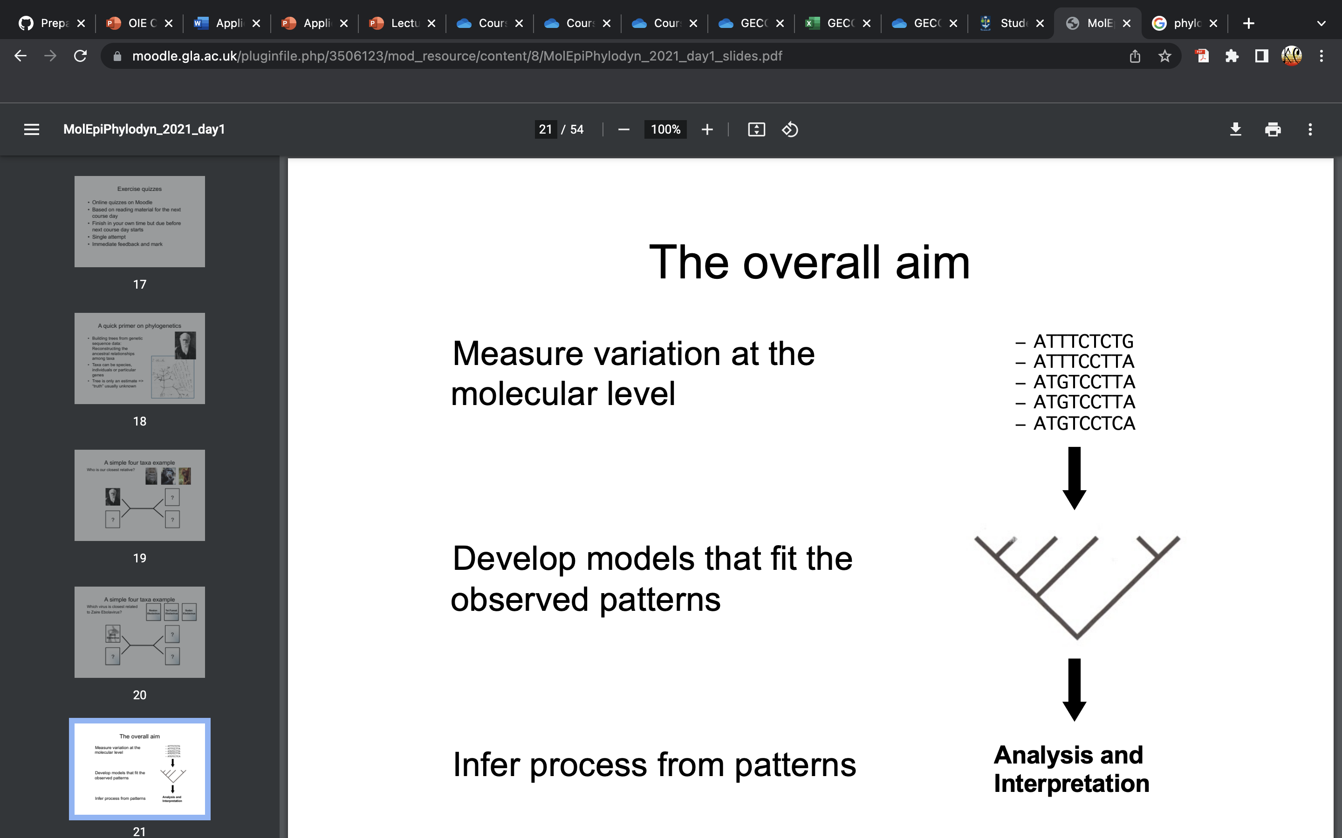
What is phylogenetics?
Building trees from genetic sequence data:
Reconstructing the ancestral relationships among taxa
Taxa can be species, individuals or particular genes
Tree is only an estimate => “truth” usually unknown
Measure variation at the molecular level
Develop models that fit the observed patterns
Infer process from patterns

Slide 10
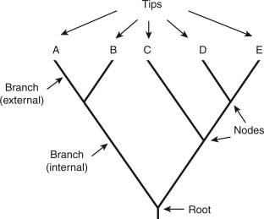
Parts of a phylogenetic tree

Slide 11
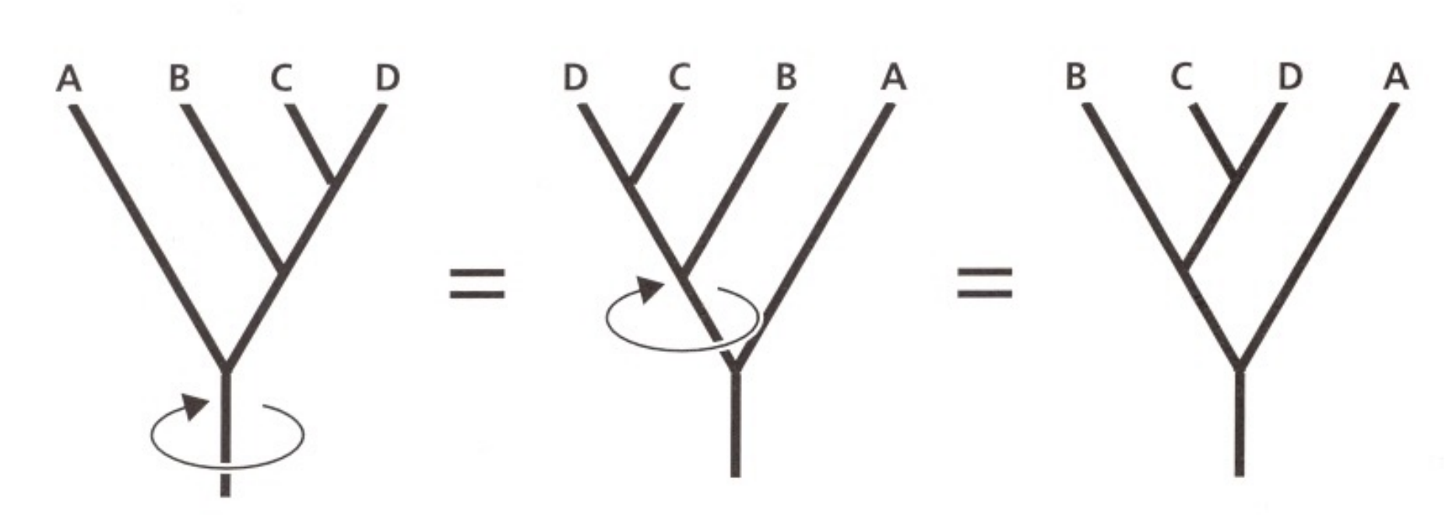
Branches can ‘swivel’

Slide 12
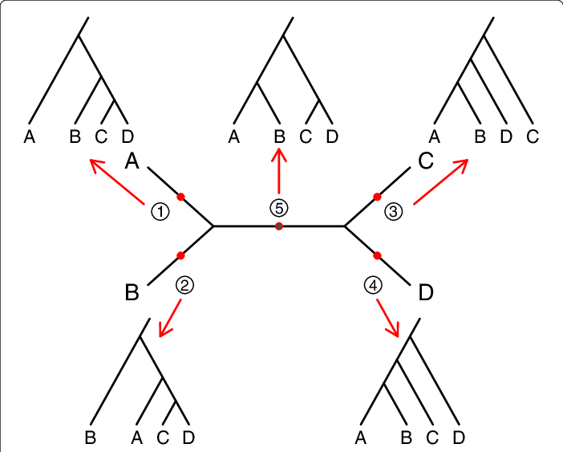
Rooting Trees
Midpoint Root

Slide 13
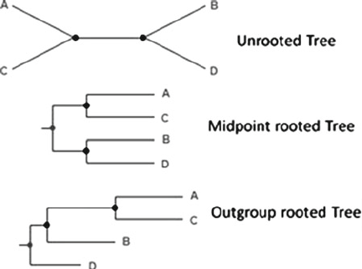
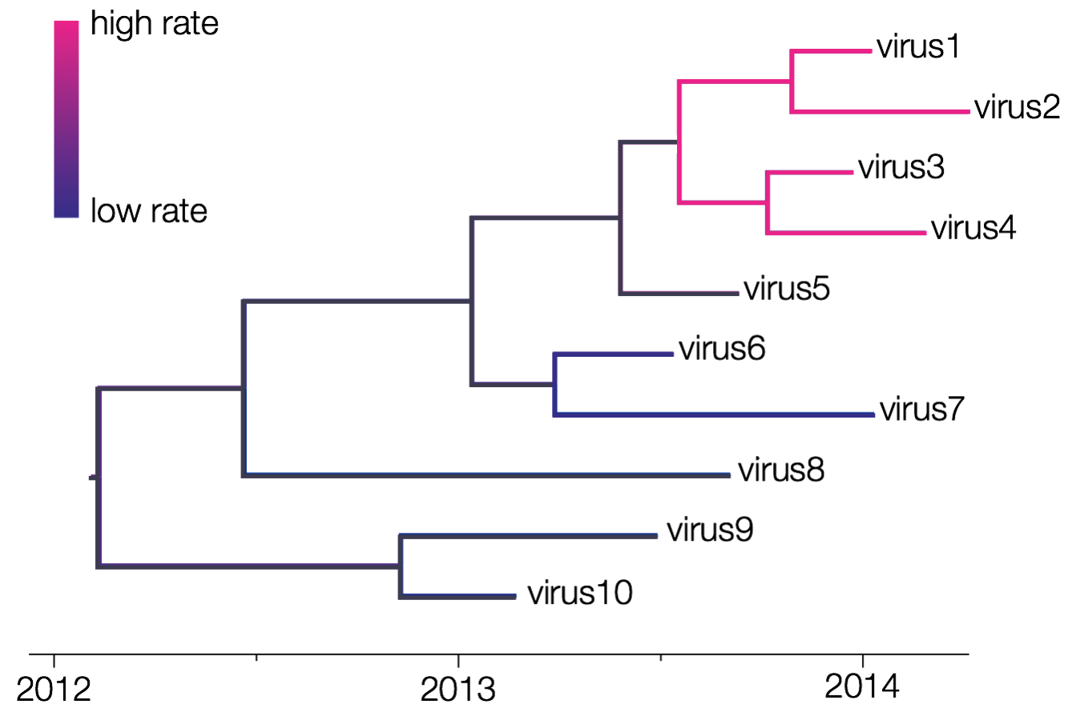
Rooting Trees
Outgroup – one or more taxa that fall outside the group of interest
Molecular clock – oriented along an axis of time

Slide 14
Monophyletic
Monophyletic – sharing a single common ancestor
Not monophyletic
Clades, subclades and lineages are monophyletic groups of sequences of increasing levels of resolution

Slide 15
Interpreting phylogenetic trees - Practical
Follow the instructions in day4_tree_visualisation.md

Slide 16
Substitution models
Markov models that describe changes over evolutionary time
Attempt to predict the rate of substitution for nucleotides or amino acids at a given site, and also the distribution of substitutions across the entire sequence
Jukes-Cantor (JC)
all nucleotides occur at the same frequency and undergo change at the same rate
General Time Reversible (GTR)
Each type of nucleotide change occurs at its own rate (e.g. A->C =/= C->A)
Kimura 2-Parameter (K2P) and Kimura 3-Parameter (K3P)
Hasegawa-Kishono-Yano (HKY)

Slide 17
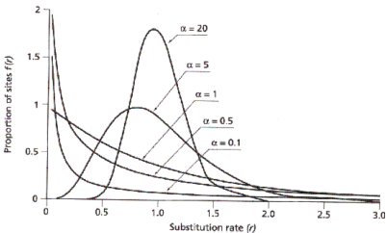
Variation among sites
Some sites undergo changes more frequently than others - can be expressed using a gamma distribution
Number of gamma categories
Slow
Fast
Some sites are are not allowed to change, as they have essential roles – these are called invariant sites

Slide 18
Interpreting Substitution Models
Substitution model – General Time Reversible
Allow invariant sites
GTR + F + I + G4
Empirical base frequencies
Gamma model with 4 rate categories

Slide 19
Tree Building Methods
Distance based
Maximum parsimony
Maximum likelihood
Bayesian methods

Slide 20
Maximum Likelihood
Maximize the probability of the sequences, given a tree and its branch lengths and an evolutionary model and its parameters
Important features
Allows full use of evolutionary models
Relies heavily on model chosen => can be misleading if there is much variation in the substitution process among lineages
Computationally much more demanding
IQTree

Slide 21
Bayesian Methods
Objective: determine the posterior distribution of trees given the sequence data
Based on this distribution, ‘best’ tree can be identified
Important features:
Allows full use of evolutionary models
Need to include priors
Posterior probabilities are approximated through Markov Chain Monte Carlo (MCMC) methods that sample from the posterior
Clade probabilities provide measure of uncertainty
BEAST

Slide 22
Bootstrapping
Artificial dataset of same size is generated by picking columns with replacement
Tree building applied to these bootstrap matrices
The frequency with which a node appears is taken as a measure of confidence for that node
ATGCAGGTA
ATGCTGCTA
ATGCAGCTC
TAGCAGGAC
ORIGINAL
AAGCCGGTA
AAGCCGCTA
AAGCCGCTC
TTGCCGGAC
GCGCAGGAA
GCGCTGCAA
GCGCAGCCC
GCGCAGGCC
ATAAGGTTT
ATTTGCTTT
ATAAGCTTT
TAAAGGAAA

Slide 23
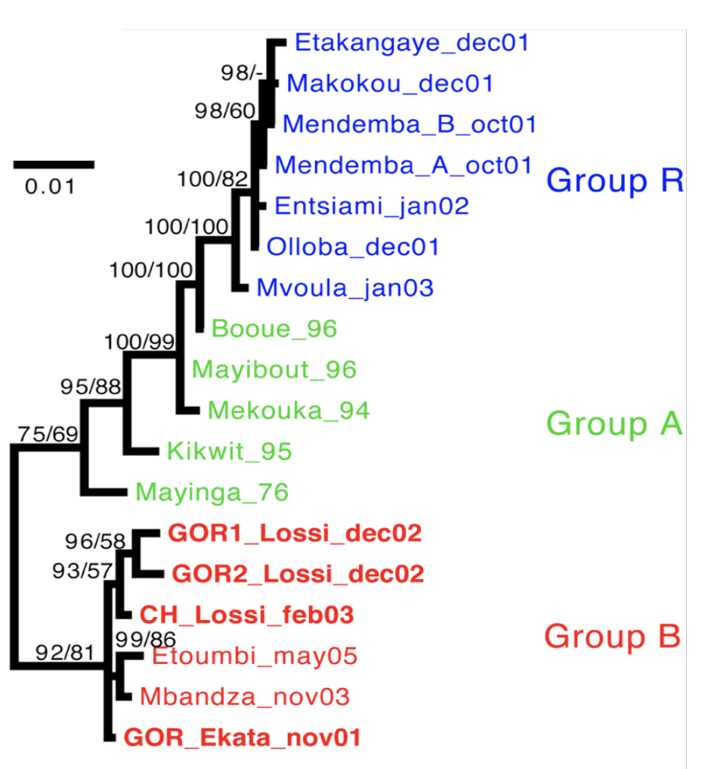
Posterior Probabilities
Count the frequency of a clade within the posterior distribution of trees
Less conservative: tend to be much higher than bootstrap values
Strong support:
Bootstrap >0.7
Posterior prob. >0.95

Slide 24
Phylogenetic Analysis Steps
Collect homologous sequences
Conduct multiple alignment
Fit an appropriate substitution model
Estimate tree(s) under that model
Test the reliability of the estimated tree(s)
Interpret and apply the phylogenetic tree
Potentially repeat steps 4-6 using different tree building methods and/or additional data

Slide 25
Phylogenetic Analysis Steps
Collect homologous sequences
Conduct multiple alignment
Fit an appropriate substitution model
Estimate tree(s) under that model
Test the reliability of the estimated tree(s)
Interpret and apply the phylogenetic tree
Potentially repeat steps 4-6 using different tree building methods and/or additional data
Follow the instructions in day4_tree_building.md

Slide 26
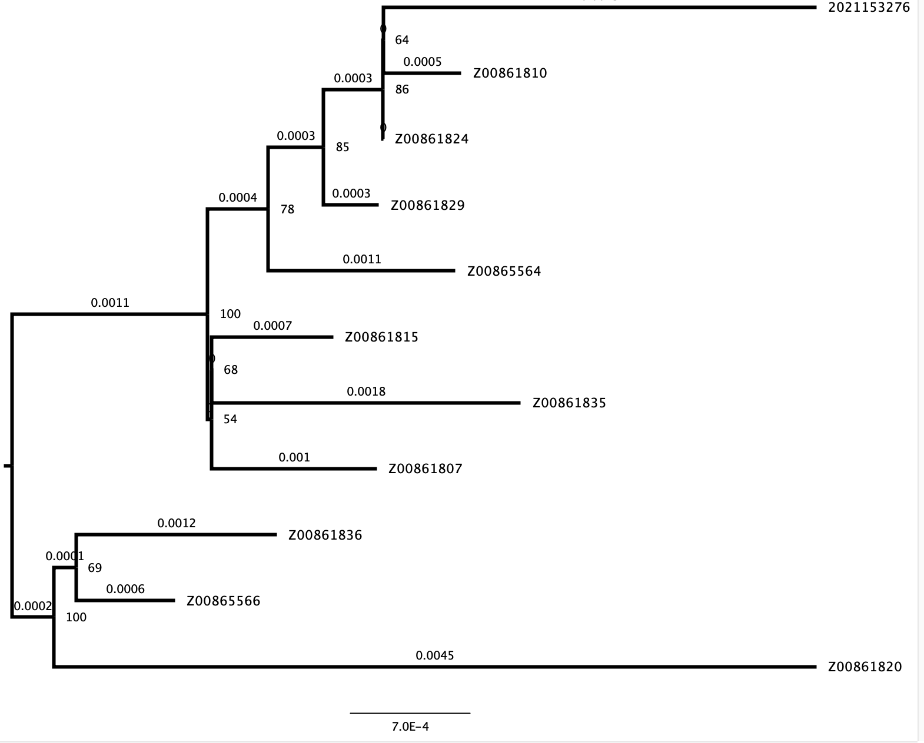
Visualizing Trees
Topology Changes:
Position of the root
“Swiveling” the branches
Ordering the nodes
Additional information:
Branch lengths
Node labels
Bootstraps
Node ages
Scale bar

Slide 27
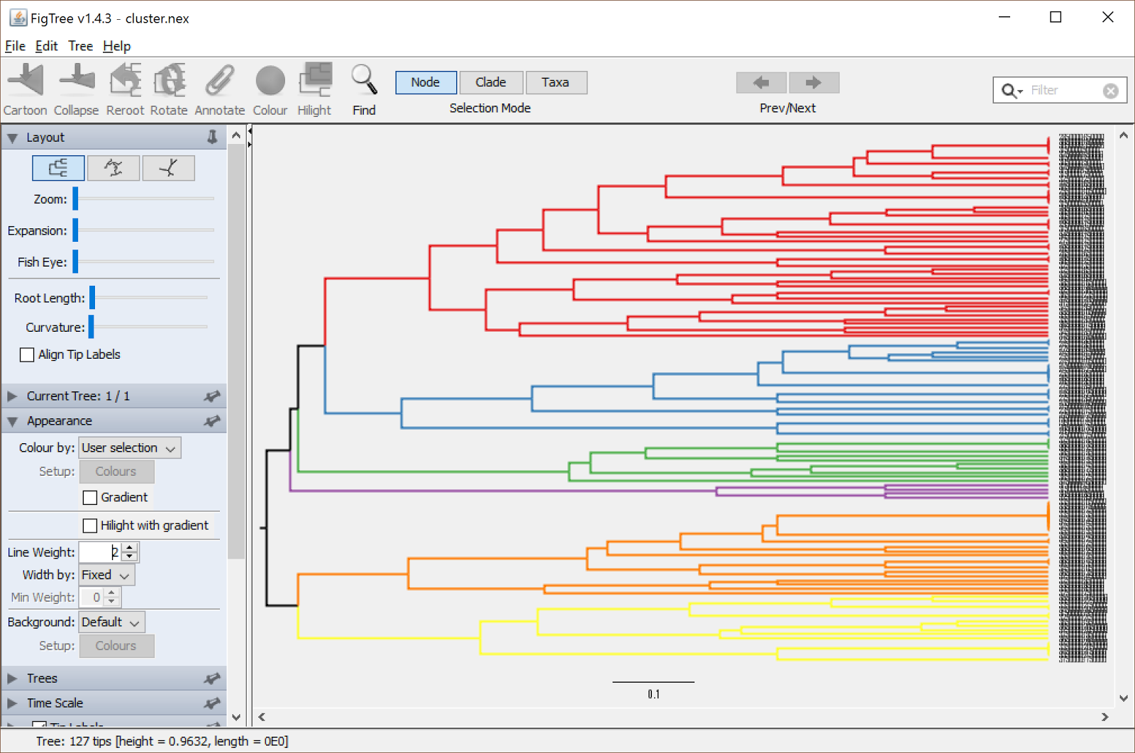
Adding Metadata
Can add useful information such as:
Species/host
Location
Lineage
Can help predict the location/host origin of a cluster

Slide 28
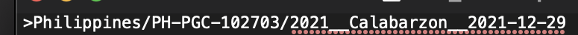
Adding Metadata
Ideally, we have a nicely formatted metadata table with information about all of our sequences. This isn’t always the case!
Sometimes the sequence ID contains useful information that needs to be extracted!
If all the IDs follow the same format, an automated pipeline to extract the information can be made!

Slide 29
Phylogenetic Analysis Steps
Collect homologous sequences
Conduct multiple alignment
Fit an appropriate substitution model
Estimate tree(s) under that model
Test the reliability of the estimated tree(s)
Interpret and apply the phylogenetic tree
Potentially repeat steps 4-6 using different tree building methods and/or additional data

Slide 30
Phylogenetic Analysis Steps
For the standard practical:
Follow instructions in day4_STANDARD_annotation.md
For more advanced bioinformaticians/ those looking for a challenge:
Follow the instructions in day4_ADVANCED_annotation.md
And for an extension activity:
day4_EXTENSION_trees_in_r.md
Collect homologous sequences
Conduct multiple alignment
Fit an appropriate substitution model
Estimate tree(s) under that model
Test the reliability of the estimated tree(s)
Interpret and apply the phylogenetic tree
Potentially repeat steps 4-6 using different tree building methods and/or additional data

Slide 31
Further Phylodynamics and Phylogeography
This will be a very brief introduction to showcase other tools and Bayesian methods.
A full step by step tutorials are available at: https://beast.community/index.html

Slide 32
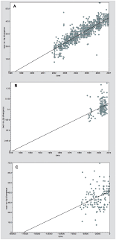
TempEst
To make time-scaled Bayesian trees in BEAST, there needs to be a strong temporal signal
Temporal signal = “clocklikeness” – measure of mutation over time
Can test this in Tempest
Mutation in reality isn’t exactly correlated to time – other factors influence mutation rate

Slide 33

BEAST
Software for Bayesian analysis of sequences using MCMC
Oriented towards rooted, time scaled trees
Allows testing of different clock and tree parameters
Are all branches evolving at the same rate?
How did the susceptible population change over time?

Slide 34
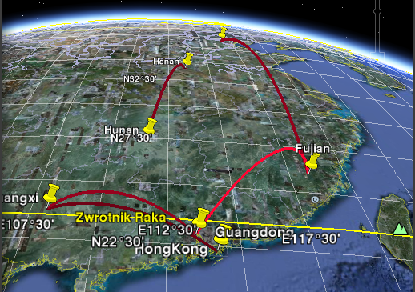
SPREAD
BEAST can include location information as well as dates
Allows recreation of how the virus spread over time
Can make maps, or be viewed as a nice video in Google Earth!

Slide 35
Phylogenetic Analysis Steps
Collect homologous sequences
Conduct multiple alignment
Fit an appropriate substitution model
Estimate tree(s) under that model
Test the reliability of the estimated tree(s)
Interpret and apply the phylogenetic tree
Potentially repeat steps 4-6 using different tree building methods and/or additional data
Follow instructions in day4_TempEst.md

Slide 36
Phylogenetic Analysis Steps
If you want to test what you’ve learnt, cement your skills and try an advanced extension activity, try:
day4_EXTENSION_followup.md
There are some parts that require having done the ADVANCED and EXTENSION options for tree visualization, but you can just skip these and still practice tree building!
Collect homologous sequences
Conduct multiple alignment
Fit an appropriate substitution model
Estimate tree(s) under that model
Test the reliability of the estimated tree(s)
Interpret and apply the phylogenetic tree
Potentially repeat steps 4-6 using different tree building methods and/or additional data

Slide 37



Good luck, and happy tree building!
#UofGWorldChangers
@UofGlasgow
@ThatKatC

